Slide 1
How to Edit a Default Alma Analytics Dashboard
Yoel Kortick
Senior Librarian

Slide 2
The question
How can I edit the Fulfillment Dashboard so it separates between “In House” and “Not In House” loans.

Slide 3
Introduction and background
Any Alma Analytics report (or dashboard or prompt) which is under the “Alma” folder cannot be edited.
All entities under the “Alma” folder are provided by Ex Libris as default reports and cannot be changed in the “Alma” folder.
They can be copied elsewhere and then changed.

Slide 4
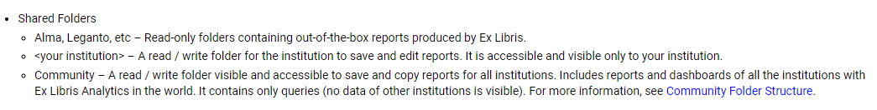
Introduction and background
For an explanation of the directory structure see: Analytics Folders:

Slide 5
The six steps
Copy the folder which contains the default dashboard
Paste the copied folder wherever you desire
Run the dashboard from this "local directory" location and see the report we want to change
Do "Edit Dashboard"
Click "edit analysis" on the report then edit and save it in the "local directory" location
Edit the dashboard to point to the new report insytesd of the default report

Slide 6
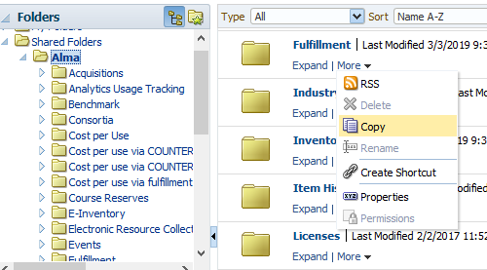
Step one
First copy the folder which contains the default dashboard:

Slide 7
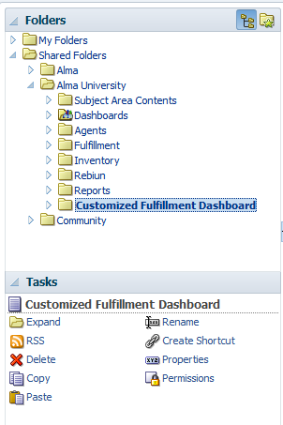
Step two
Paste the copied folder wherever you desire

Slide 8
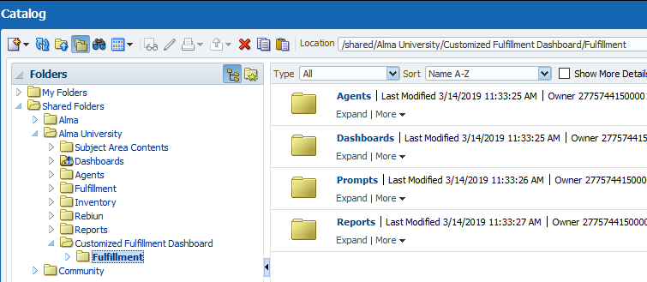
Results after step two
Now we have a copy of the default dashboard in a folder where we can edit it. We also have the reports of the dashboard.

Slide 9
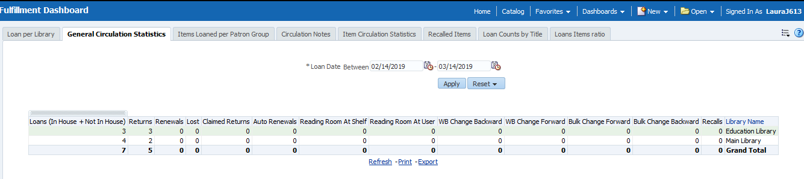
Step three
We run the dashboard from this “local directory” location and see the report we want to change
Instead of one column with “Loans (In House + Not In House) we want to separate this into two columns

Slide 10
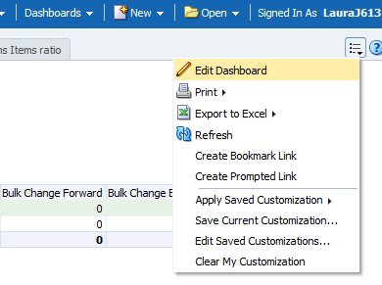
Step four
From this tab of the dashboard we choose “edit dashboard”

Slide 11
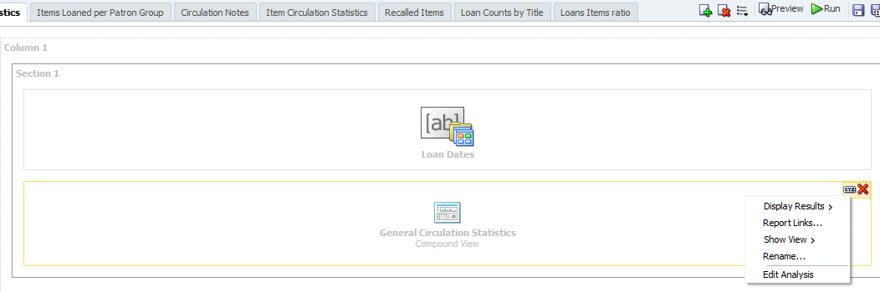
Step five
Now we will click “edit analysis” on the report, edit and save

Slide 12
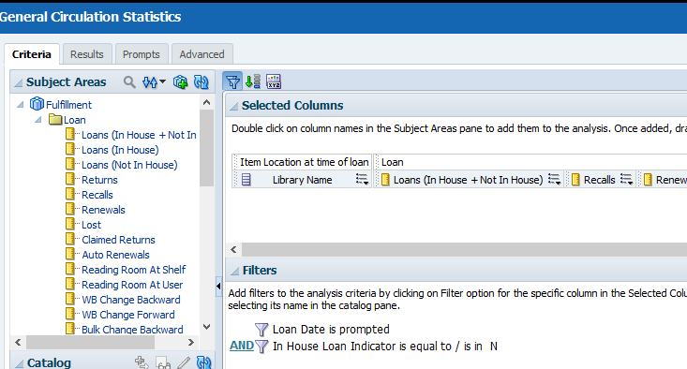
Step five (continued)
Now edit the report
Add these
Delete this

Slide 13
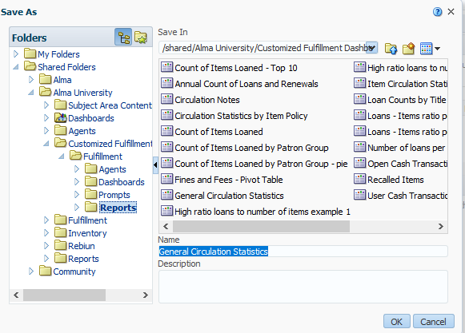
Step five (continued)
After making sure it works as desired save it in the local folder directory

Slide 14
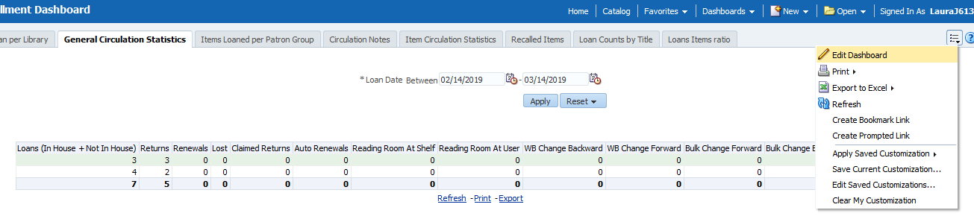
Step six
Now we need to edit the dashboard to point to the new report. The dashboard is in a local folder but it is still “pointing to” the reports under the Alma folder.

Slide 15
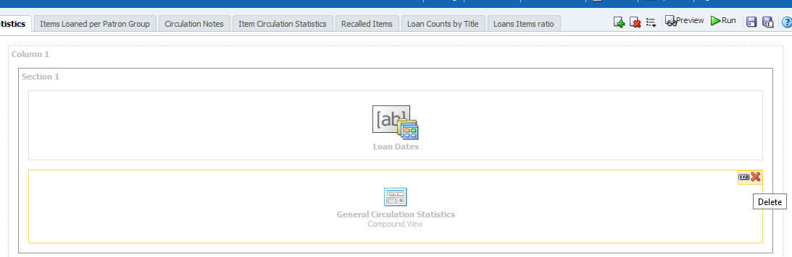
Step six (continued)
Delete the link to the old report

Slide 16
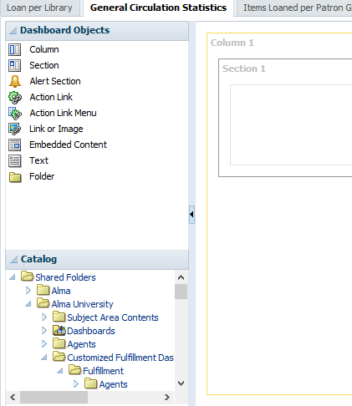
Step six (continued)
Navigate to the new report and drag into the dashboard

Slide 17
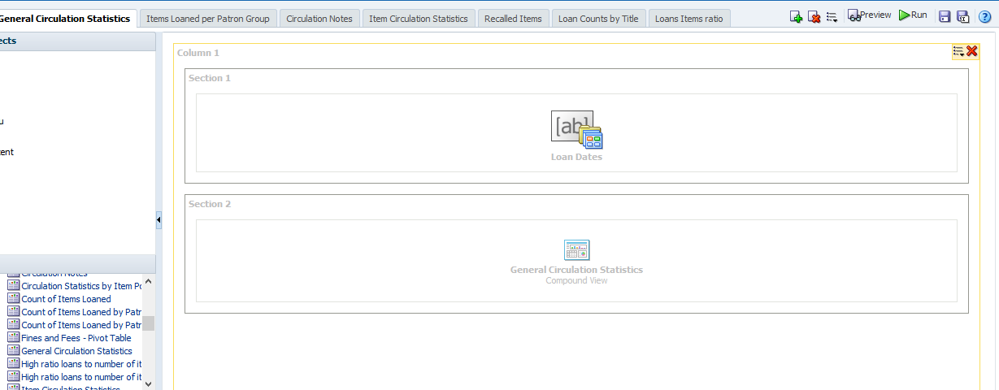
Step six (continued)
Drag the new report into the dashboard

Slide 18
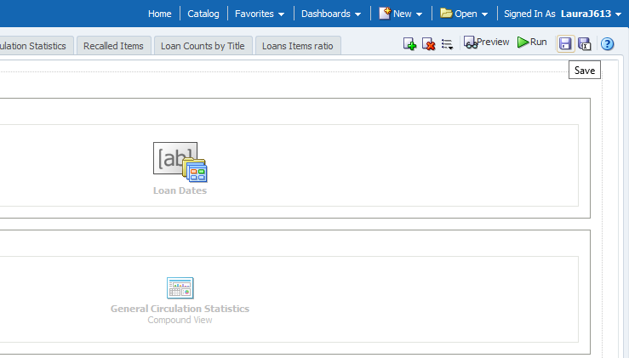
Step six (continued)
Save the newly edited dashboard

Slide 19
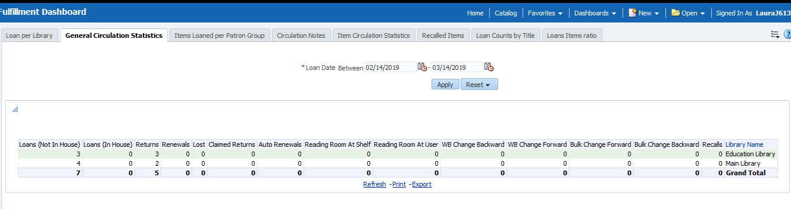
The results
Now we have the customized dashboard with Loans separated into two separate columns of “in house” and “not in house”.

